Slide 1
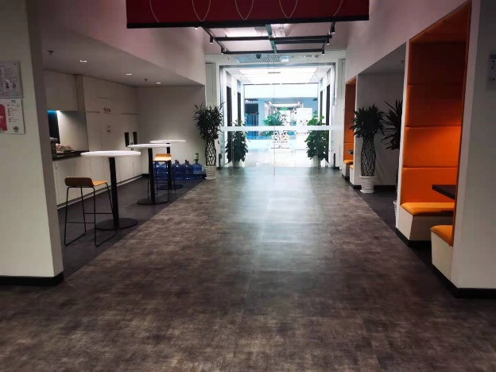
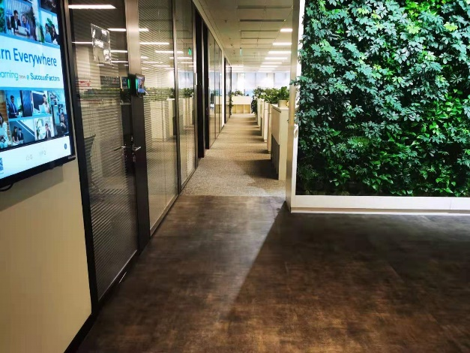
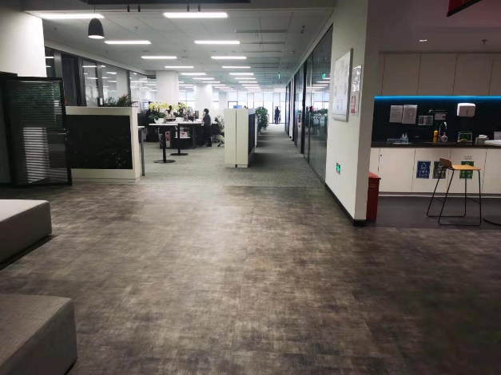
Q manager plan (Floor 6, out of the East 08 meeting room)
East 08 Meeting room
Office area
Glass Door need to be shut
Mr. Eichhorn
Grass wall
Camera
2*Q managers needed here
3*Q managers
2*Q managers
Meeting room
Pantry
Meeting room
3*Q managers needed here
Glass Door

